Slide 1
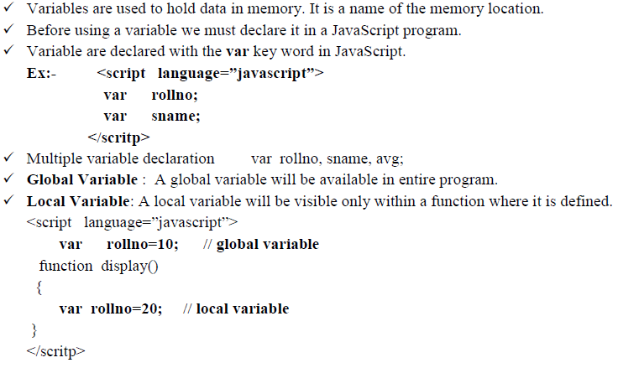
Variable declaration in Java Script:-

Slide 2
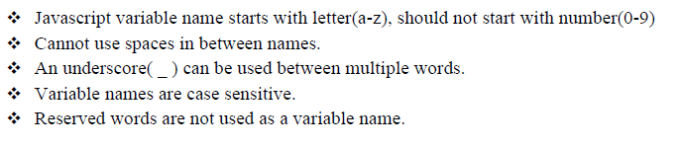
Variable Rules:-

Slide 3
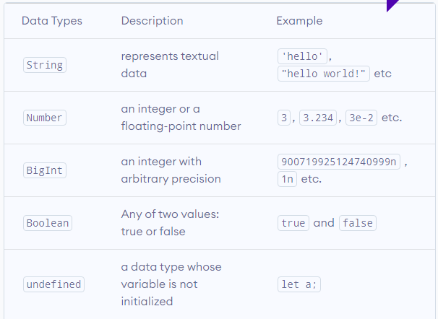
JavaScript Data Types

Slide 4
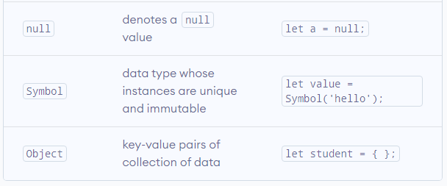

Slide 5
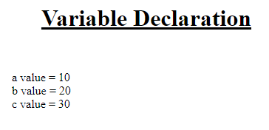
<html>
<head> <title> </title></head>
<body>
<h1 align=center><u> Variable Declaration </u></h1>
<script language="JavaScript">
var a = 10;
var b = 20;
var c = a+b;
document.writeln(" a value = ",a);
document.writeln(" <br> b value = ",b);
document.writeln(" <br> c value = ",c);
</script>
</bdoy>
</html>

Slide 6
Values read at runtime
<html>
<head> <title> </title></head>
<body>
<h1 align=center><u> Variable Declaration </u></h1>
<script language="JavaScript">
var a = window.prompt(" Entet a value");
var b = window.prompt(" Entet b value");
var num1 = parseInt(a);
var num2 = parseInt(b);
var c = num1+num2;
document.writeln(" a value = ",a);
document.writeln(" <br> b value = ",b);
document.writeln(" <br> c value = ",c);
</script>
</bdoy>
</html>

Slide 7
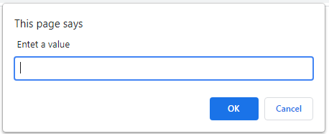
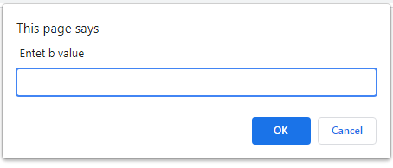
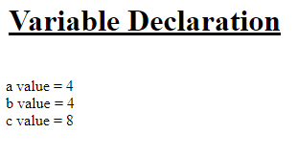

Slide 8
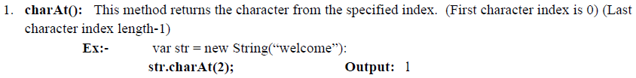
STRING MANIPULATIONS:
While JavaScript has many applications, working with string values is one of the most popular. Strings are objects within the JavaScript language. They are not stored as character arrays, so built-in functions must be used to manipulate their values. The functions provide various ways to access the contents of a string variable.
String Functions:

Slide 9
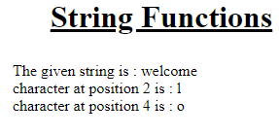
<html>
<head> <title> Strings </title></head>
<body>
<h1 align=center><u> String Functions </u></h1>
<script language="JavaScript">
var a = window.prompt(" Entet any string");
document.writeln(" The given string is : ",a);
var b = a.charAt(2);
document.writeln(" <br> character at position 2 is : ",b);
var c = a.charAt(4);
document.writeln(" <br> character at position 4 is : ",c);
</script>
</bdoy>
</html>

